Slide 1
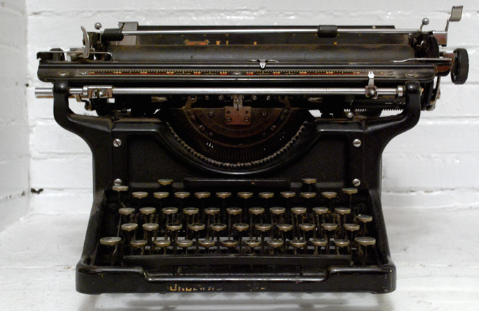
The Once and future pedagogy: Engagement through new and old technologies
University of Iowa
IDEAL
Fall 2015 Assignment Design Institute
Margaret Konkol
New College of Florida
@mekonkol
mkonkol@ncf.edu

Slide 2
Resources
DIGITAL PEDAGOGY AT NCF https://digitalpedagogyatncf.wordpress.com/2015/01/27/digital-pedagogys-first-meeting/
DIRT http://dirtdirectory.org/
TAPOR http://www.tapor.ca/
TWINERY http://twinery.org/
WORDPRESS http://wordpress.com
DRUPAL https://assoc.drupal.org/web-sites-non-profit-organizations
ANNOTATION STUDIO http://hyperstudio.mit.edu/projects/annotation-studio/
MALLET http://mallet.cs.umass.edu/index.php
JUXTA http://www.juxtasoftware.org/
OMEKA https://omeka.org/
SCALAR http://scalar.usc.edu/
SKETCHUP http://www.sketchup.com/
VOYANT http://voyant-tools.org/
QR CODE GENERATOR http://www.visualead.com/qr-code-generator/url/

