Slide 1

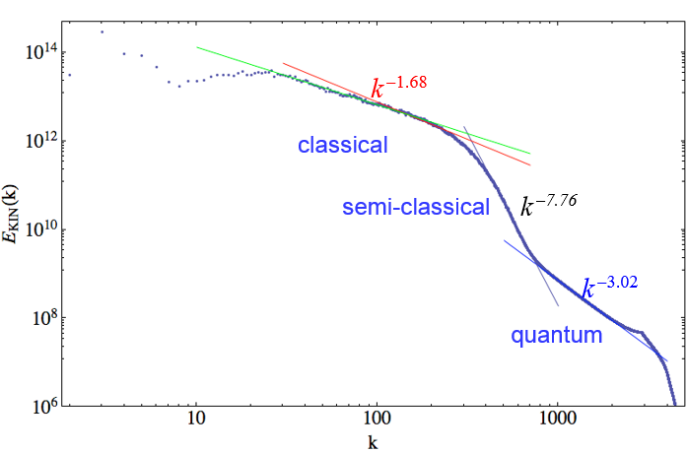
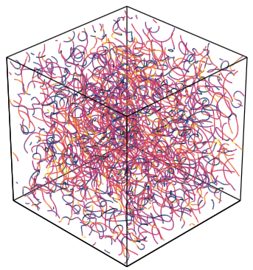

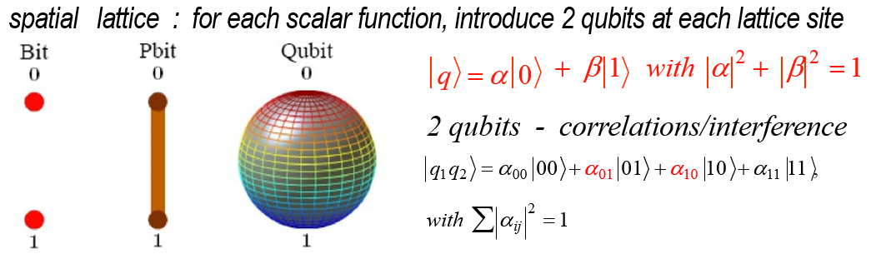
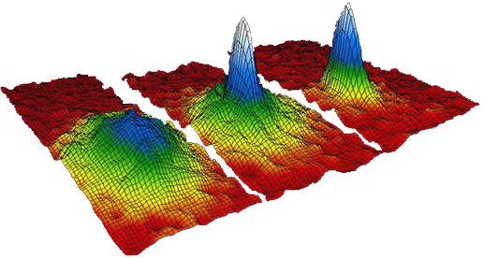


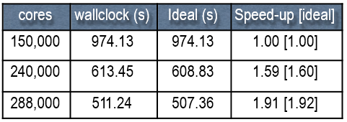
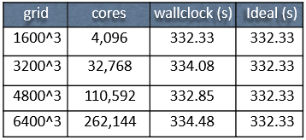
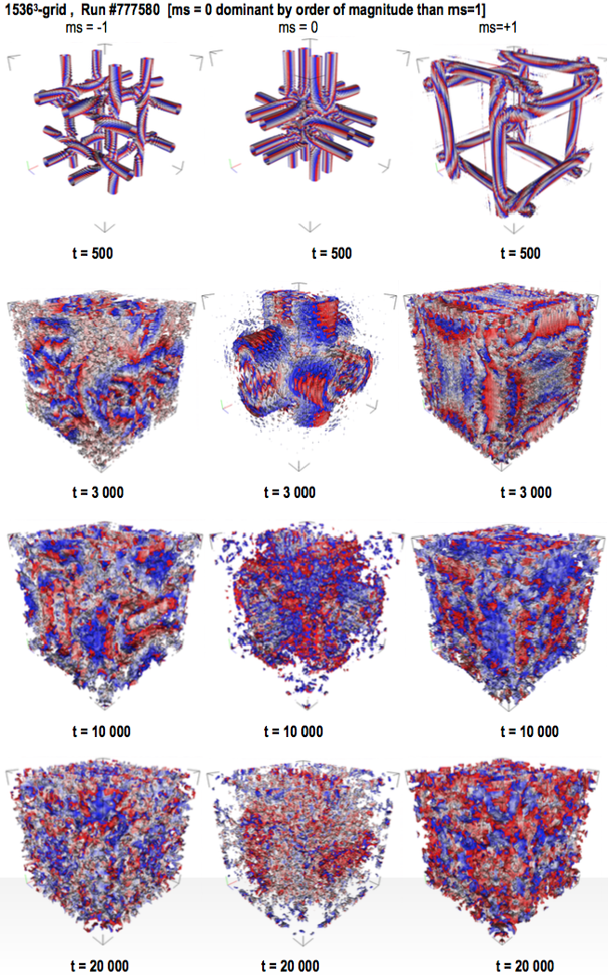
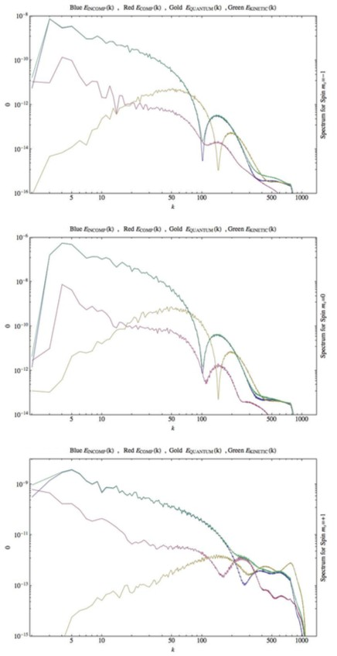
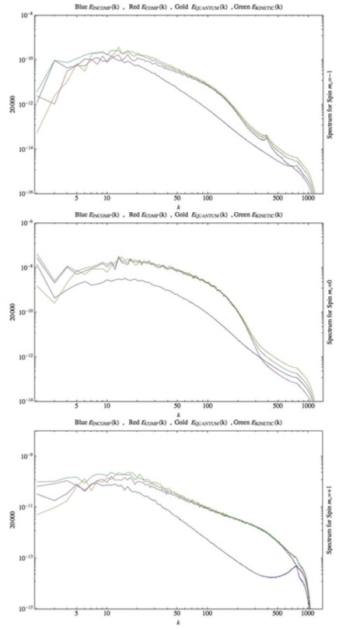


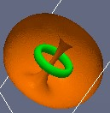
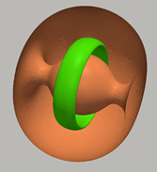
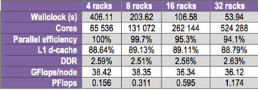

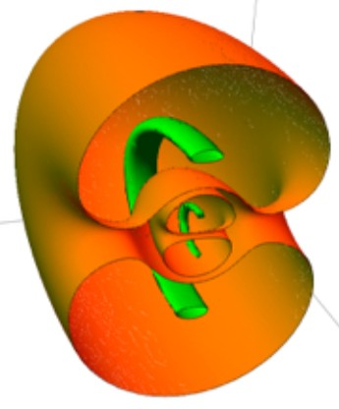
Novel Massively Parallelized Mesoscopic Algorithms for Quantum Turbulence
Research Team
Linda Vahala,
-OLD DOMINION UNIV.
George Vahala, Armen Oganesov, Chris Flint,
-WILLIAM & MARY
Min Soe,
-ROGERS STATE UNIV.
Jeffrey Yepez, AFRL-HAWAII Sean Ziegeler, -ENGILITYCORP
Background
There is a need for high resolution quantum turbulence simulations
Quantum Turbulence
Generation of Turbulence
Bose-Einstein Condensate (BEC)
Classical vs. Quantum Turbulence
Fundamental to superfluid turbulence is the quantum vortex: a topological singularity with the superfluid density exactly zero at the vortex core
BEC is the quantum fluid used to generate turbulence since it has macroscopic quantum effects (since all bosons in same state)
extremely high precision interferometry
BECs in optical lattice : building blocks for a quantum computer
quantum turbulence vs. classical turbulence
ideal in which to study non-Abelian structures (spin-2)
Multi-Scale Physics
Triple Cascade Regions:
-small k: Kolmogorov-like classical
-medium k: semi-classical regime
-large k: quantum vortex spectrum
Unitary Qubit Lattice Algorithm
-Quantum turbulence is envisaged to arise from dense quantum vortex tangles
-vortex reconnection, loop vortices even without any dissipation
-compressibility plays an important role : singular vortex cores (density zero)
Mesoscopic lattice algorithm:
very small requirements on computer memory e.g., can run 5760^3 grid using only 12 K cores in 2009.
Classical
-Viscosity is critical for classical reconnection
-Circulation is a continuous variable: very hard to define what is a classical vortex
Gross-Pitaevskii (GP) equation : At sufficiently low temperatures, the ground state wave function, ϕ, of a BEC can be described by the (normalized) GP equation:
scalar GP:
Quantum
-Flows freely, without the dissipative effect of viscous forces
-Rotation is constrained to discrete vortex lines of known size and strength.
CAP-2 (Einstein 2009, 12 288 cores
Total Kinetic Energy Spectrum grid 5760³
Hamiltonian:
Computational Results
Quantum turbulence tangles
Etotal = const
• Titan (CRAY XK7 : 299,008 CPUs + [261,632 GPUs ])
Bose–Einstein condensate sample
Quantum Vortices
Introduce the mesoscopic spinor field:
strong scaling
weak scaling
Topological defects in phase transition in BEC result in quantum vortex
Grid 9600^3 - only CPUs
BEC Turbulence
The signature of the topological defect/quantum vortex is how the order parameter changes in a closed path around the defect.
The group structure of these topological defects/quantum vortices yields valuable information on how/if quantum vortices from one equivalence class interact with other equivalence classes.
Order Parameter: spinor wave function :
Skyrmions:
m = -1
parallelization efficiency 99.2%
Problem using TITAN and its GPUs:
Computational intensity is too low - so we see saturation effects on thousands of CPU/ GPU chips. Basically, the original GPU chips did not communicate with each other.
Ψ
=
ψ ₊
Mira (IBM BG/Q : 786,432 cores , 10 PF)
ψ−
f = ¹
ψ ₊= vortex ring core
ψ ₋ core = line vortex + spherical bulb
m = 0
strong scaling
weak scaling
2
Grid 9600^3 – to full 48 racks
1 MPA rank/core
coreless vortices
alkali atoms : electron spin s, nuclear spin i
hyperfine interactions with f = s + i
m =+1
2 interlaced skyrmions
parallelization efficiency 98.6%
OpenMP timings, Grid 5120^3 – 32 racks, 1.17 Peta Flops
4 MPI ranks/core
t = 0 t = 20k
parallelization efficiency 94.1%

