Slide 1

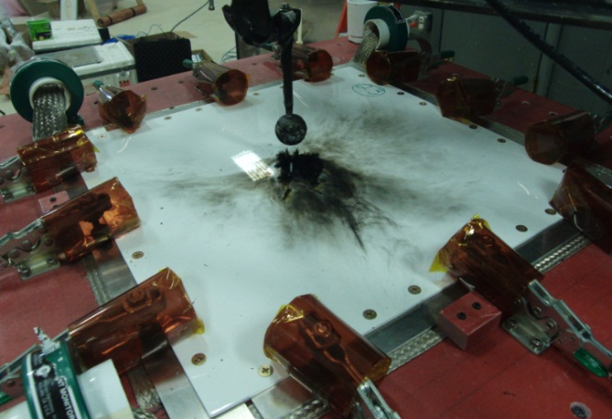
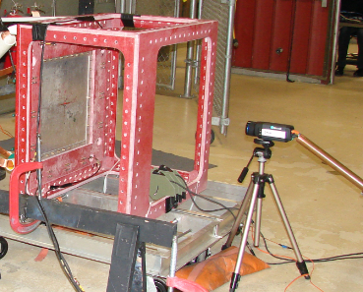
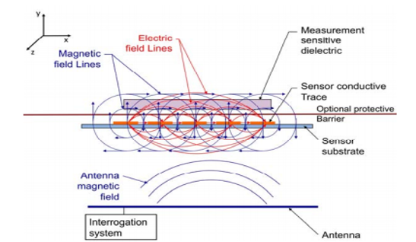
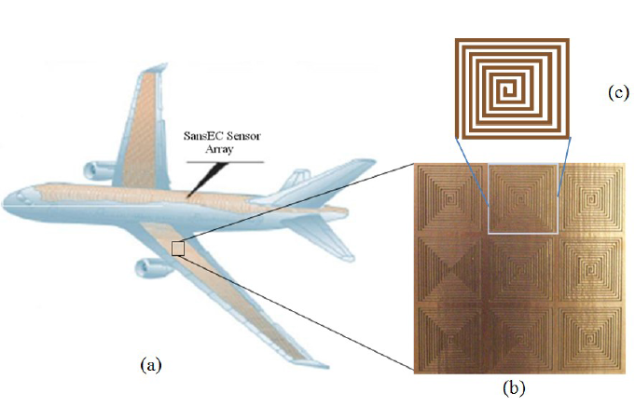
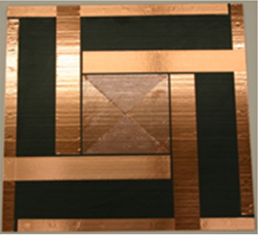
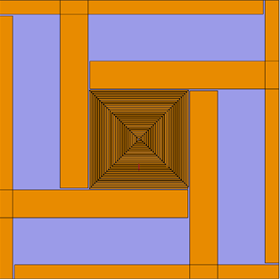
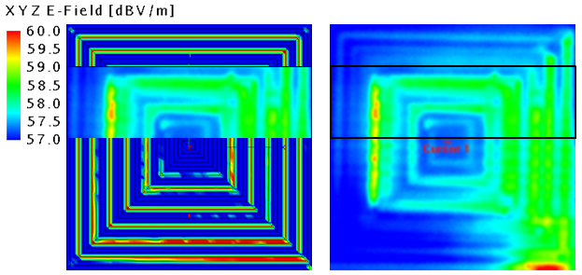
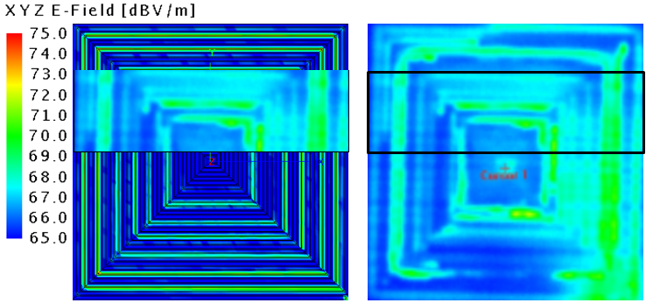
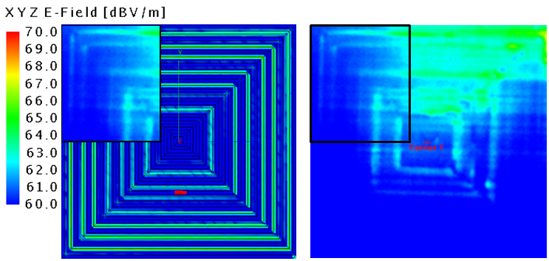
Sans Electric Connection Sensor Research
Our research expertise is in the study of electromagnetic radiation and its effect on the direction of lightning propagation
Research Team
Dr. Linda Vahala, Associate Dean
College of Engineering and Technology
Kayla M. Farrow, Graduate Student
Research Goals and Objectives
Present a correlational study of the sensor’s computed electric field distribution to the measured lightning attachment location for various SansEC sensor configurations.
Compare experimental test data to computational E-field data to show correlation results.
Facilities and Capabilities
When the sensor is placed on a composite substrate, the electric impedance of the substrate is reflected in the sensors resonant response thus enabling it to detect permittivity and conductivity changes associated with composite damage
Carbon fiber test panel installed in test bed
at Lightning Technologies facility
IR Camera used in test bed to capture backside
Temperatures at Lightning Technologies facility
Approach
Potential Impact
Understanding the correlation between electromagnetic fields and lightning propagation and attachment is critical to the SanEC sensor lightning strike protection.
Electromagnetic simulations and modeling geometries were made using FEKO software.
For each simulation, sufficiently identified the E-field and H-field structure of the SansEC sensors, then calculated the field strength at very close distance to the SansEC geometry.
Compared E-field distribution to the lightning test IR image to correlate the locations of high E-fields to the higher temperatures seen in the IR image.
(a) Smart Skin
(b) Multifunctional SansEC Sensor Array
(c) Individual Multifunctional SansEC Sensor
Actual test panel
Computation model of test panel
Results
All three sensors showed reasonable correlation between the high E-field regions to the locations with higher temperature and propagation.
                Application of the SanEC sensor on an aircraft exterior requires lightning protection
7-inch
8-inch
9-inch
Future Research
Higher relative E-fields at other resonance frequencies may also influence lightning attachment.
E-Field IR Image
E-Field IR Image
E-Field IR Image

