Slide 1

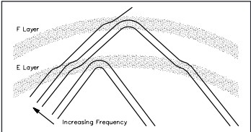

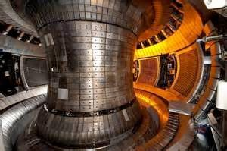
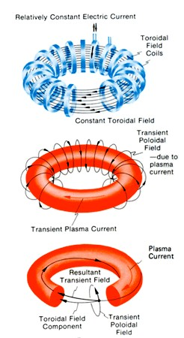
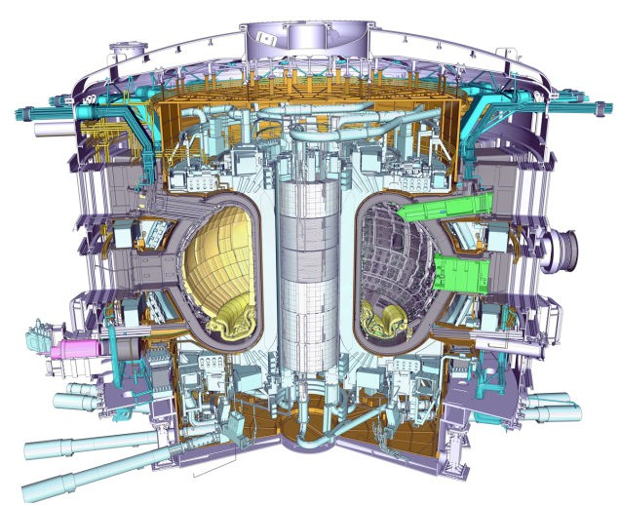
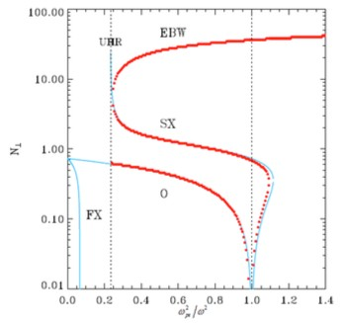
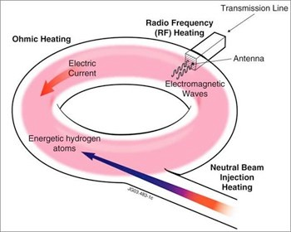
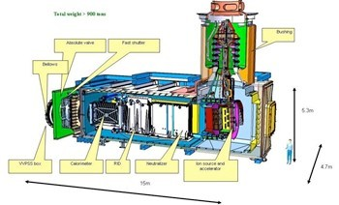
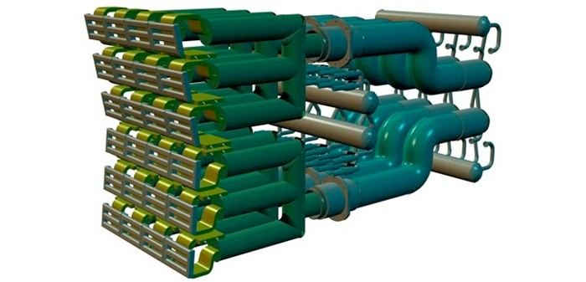
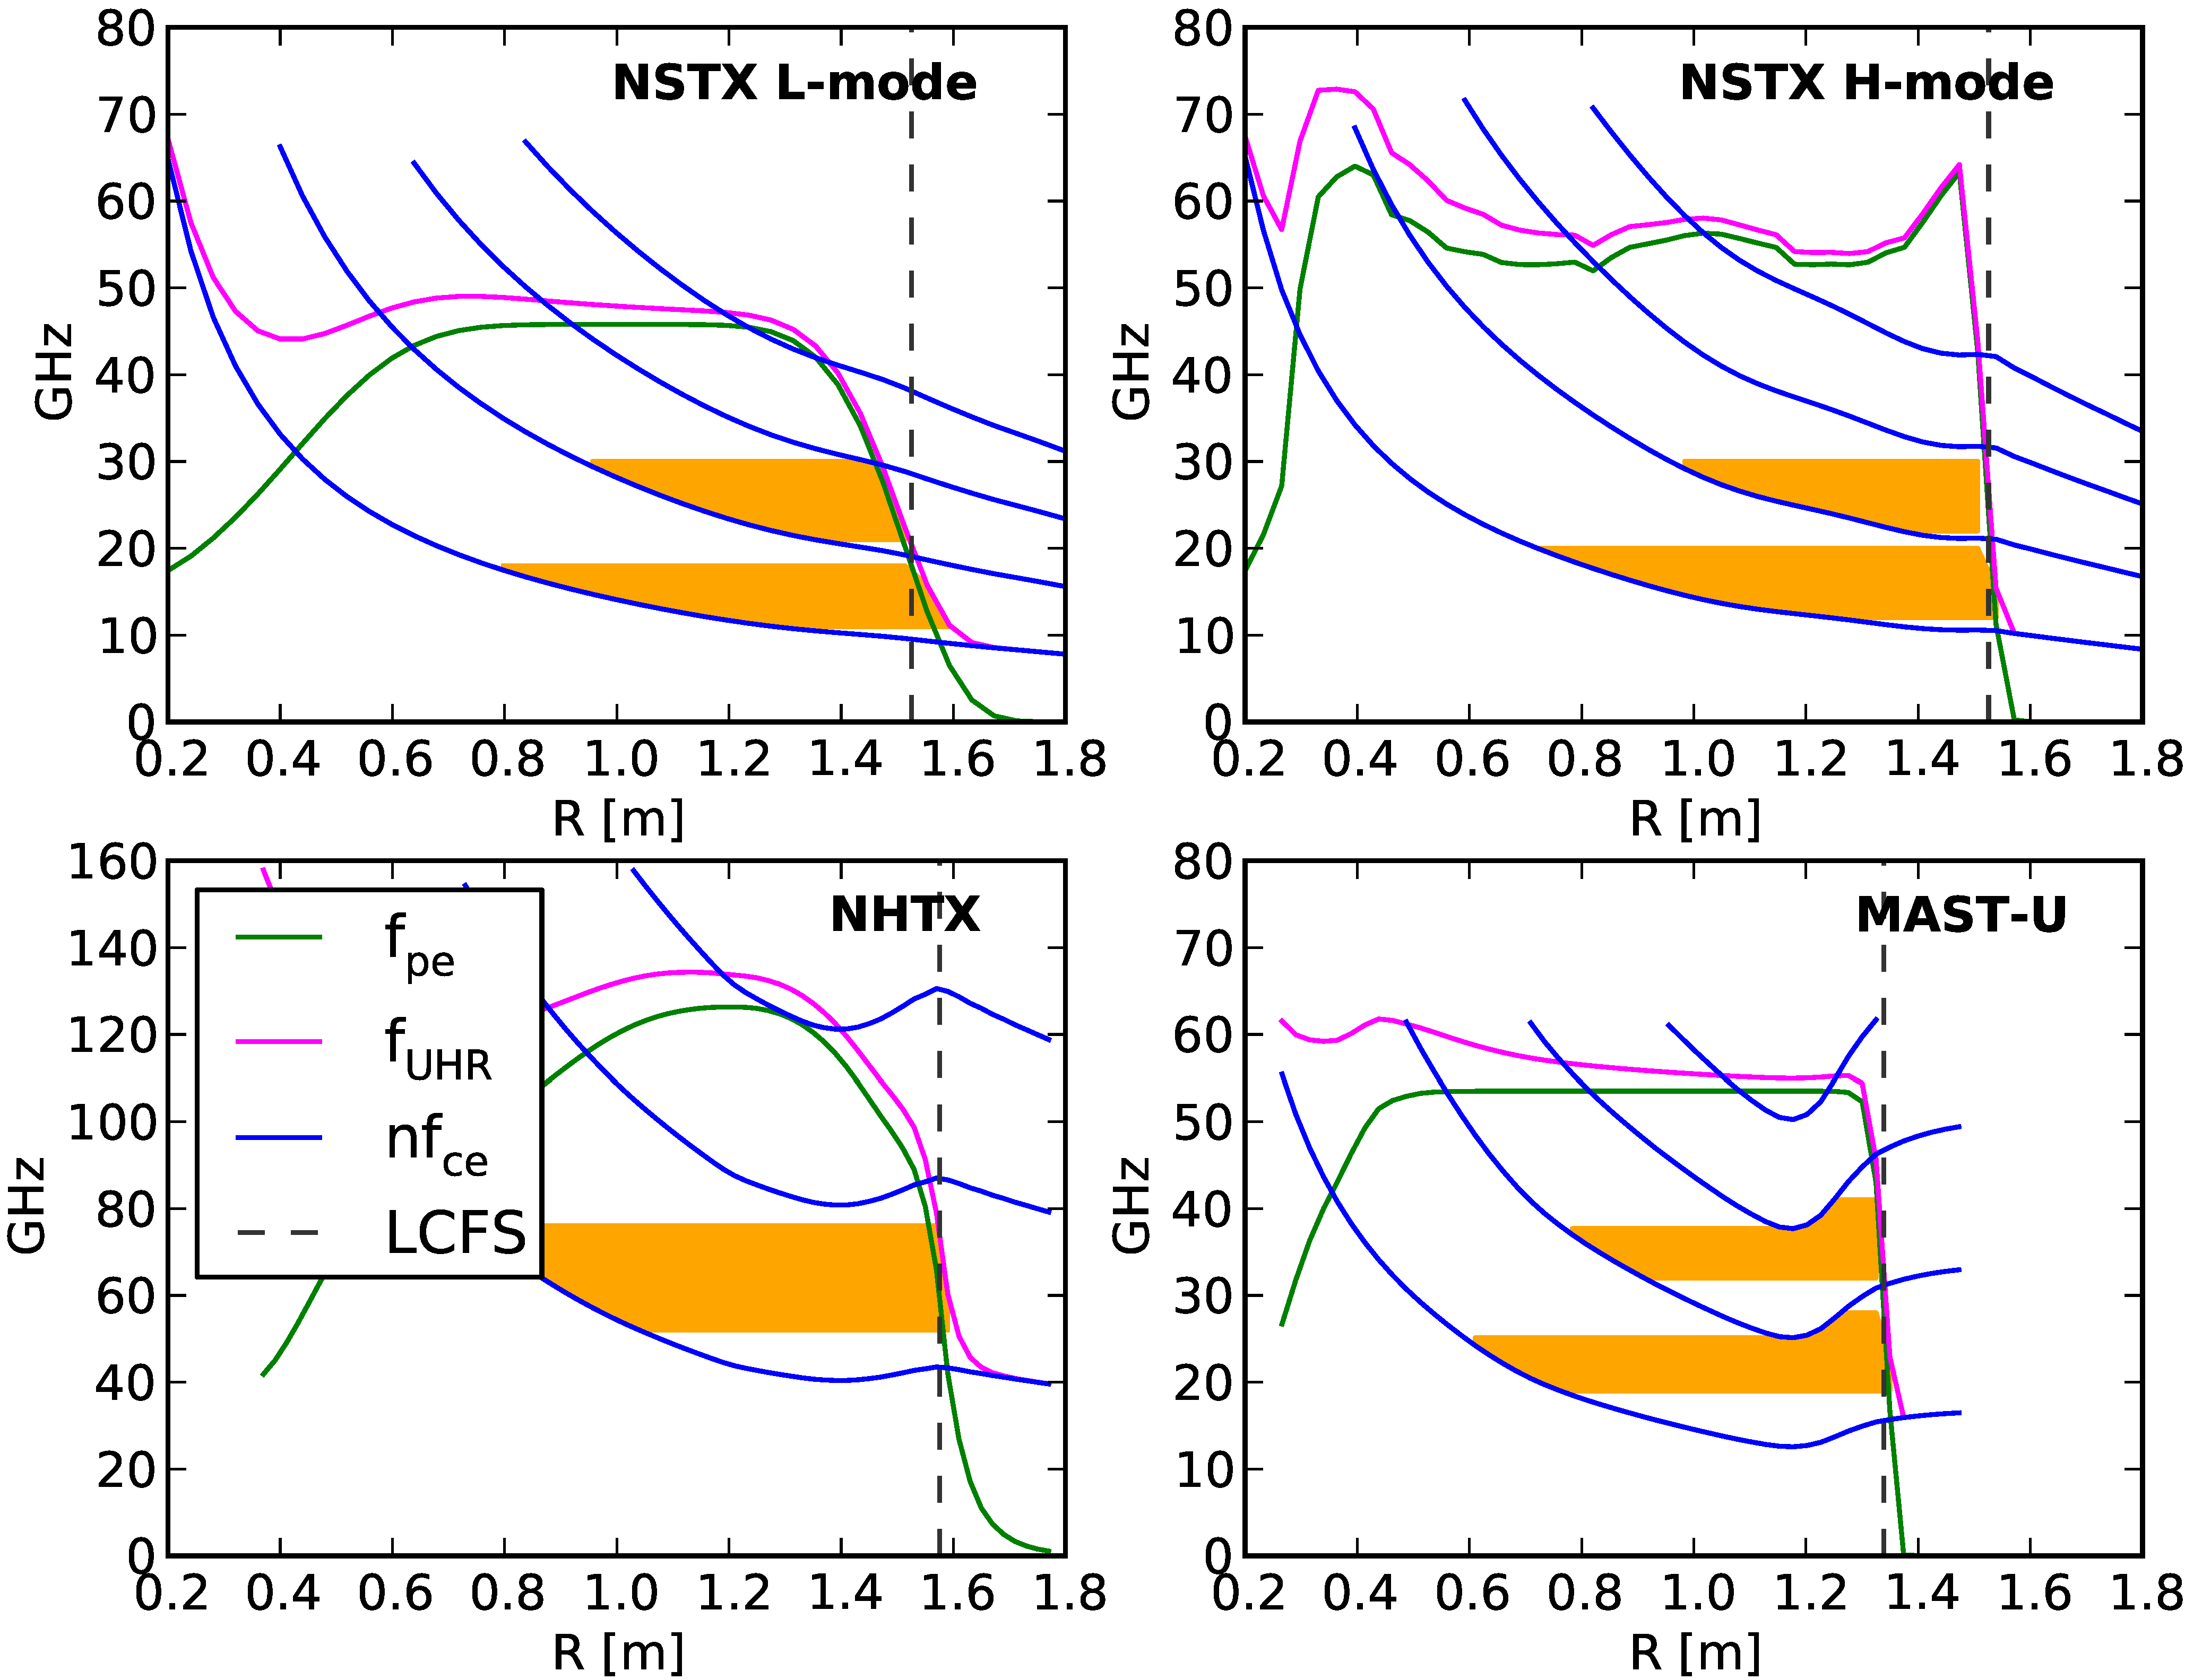
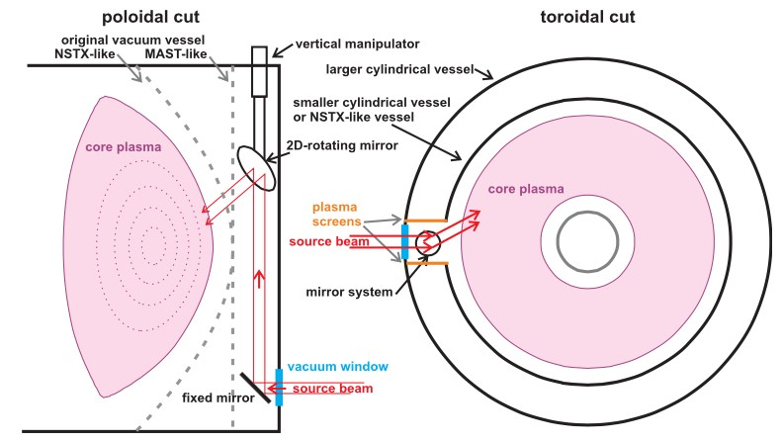
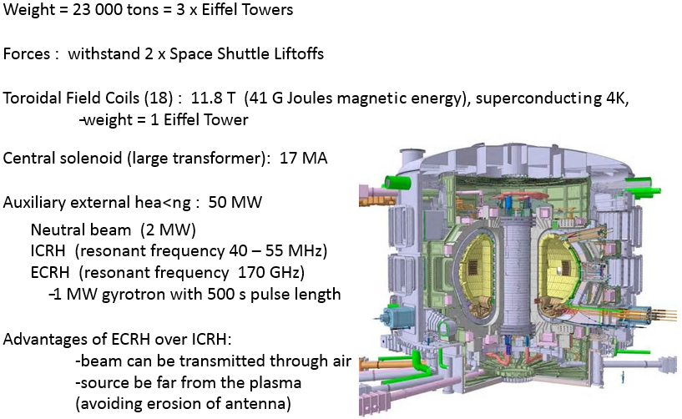
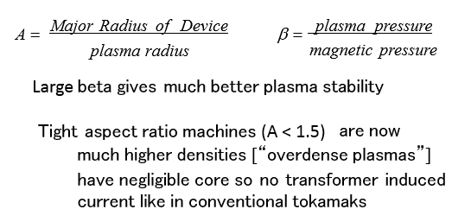
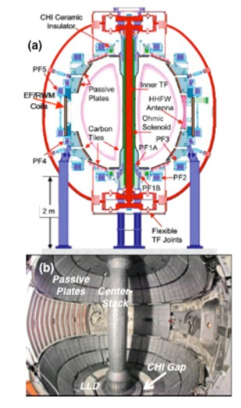
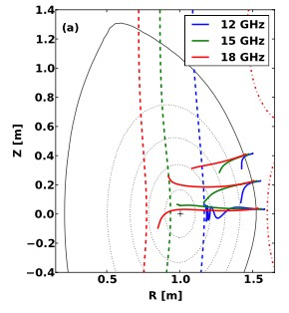
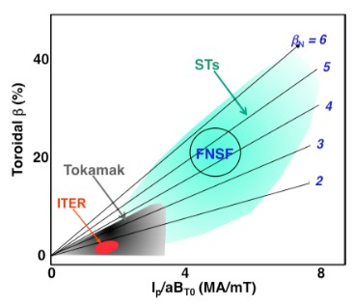
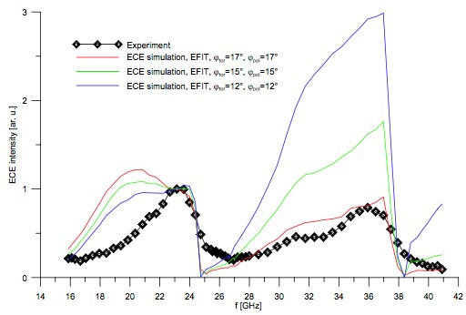
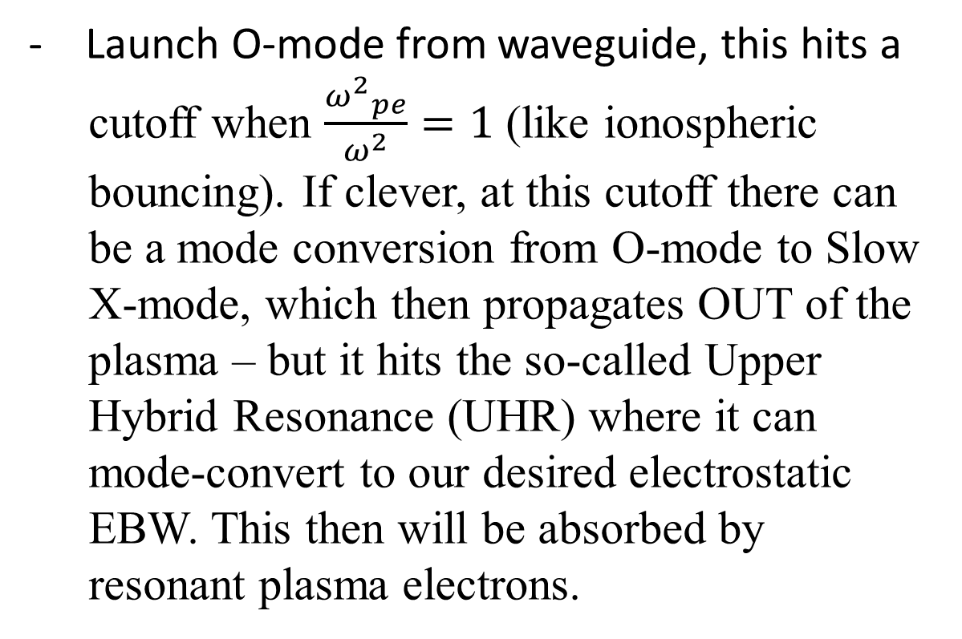
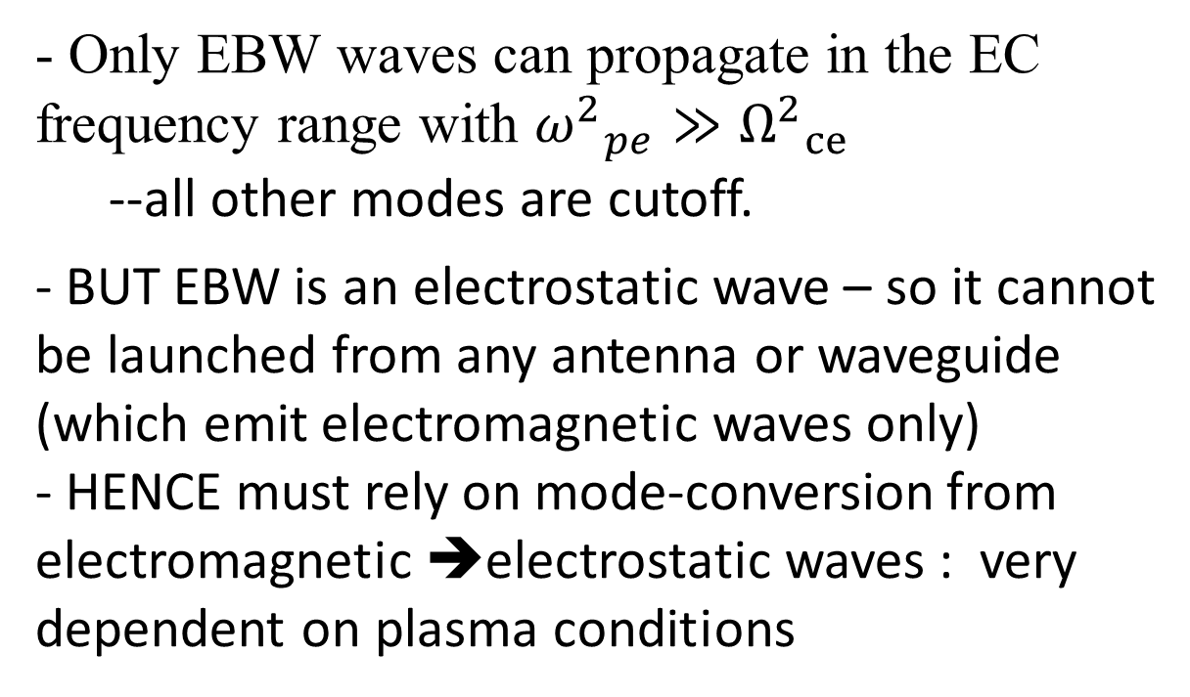
Electromagnetic Wave Propagation in Advanced Tokamaks
Research Team
Linda Vahala, Associate Dean
ODU College of Engineering and Technology
in collaboration with:
J. Reinhaelter (IPP, Czech)
J. Urban (IPP, Czech)
G. Vahala (W&M)]
Background
Successful magnetic confinement will solve most of the world’s energy needs
Wave Propagation
In Plasma
Controlled Fusion: Magnetic Fusion
Tokamak : magnetic conﬁnement
Standard Tokamak (TFTR, JET, ITER)
-­‐ Large aspect ratio > 3
Toroidal magnetic ﬁeld (4-­‐9 T)
Transformer through center :
drives a toroidal current➔ poloidal magnetic ﬁeld
This gives shear to the magnetic ﬁeld lines – needed
for plasma stability. The toroidal current not only forms the needed poloidal magnetic ﬁeld – but it also provides for ohmic heating of the plasma:
problem: the ohmic heating is insuﬃcient to reach ignition temperatures. (as the plasma heats up it becomes a better conductor and becomes less resistive!)
-wave propagation in vacuum : no problems – just one type of wave (“electromagnetic”)
-in plasmas, however, the dispersion relation on will tell you which waves can propagate, which waves are cutoﬀ …..
e.g., earth – ionosphere act as a “waveguide” but only for suﬃciently low frequency (AM) waves (particularly at night here due to lower ionization eﬀects by the sun)
In ST Tokamaks
Some headaches due to high-density plasma:
- Only EBW waves can propagate in the EC frequency range with ${ω^{2}}_{pe}≫{Ω^{2}}_{ce}$
--all other modes are cutoff.
- BUT EBW is an electrostatic wave – so it cannot be launched from any antenna or waveguide (which emit electromagnetic waves only)
- HENCE must rely on mode-conversion from electromagnetic ➔electrostatic waves : very dependent on plasma conditions
- Launch O-mode from waveguide, this hits a
cutoff when $\frac{{ω^{2}}_{pe}}{ω^{2}}=1$ (like ionospheric bouncing). If clever, at this cutoff there can be a mode conversion from O-mode to Slow X-mode, which then propagates OUT of the plasma – but it hits the so-called Upper Hybrid Resonance (UHR) where it can mode-convert to our desired electrostatic EBW. This then will be absorbed by resonant plasma electrons.
External Heating Sources
ICRF Antenna
Neutral Beam Injector (900 tons)
Neutrons are emitted in fusion. Being uncharged particles they are not aﬀected by B‐ﬁeld -­‐- hence will bombard the inner wall of the tokamak :
i.e., they can cause damage to
Neutral beam injector, ICRF antennas …..
Experimental and Theoretical Data
Advanced Tokamaks
Possible frequency ranges (shaded)­
-Determined by plasma equilibria
EBW Launcher, with vertically movable antenna
ITER – World-wide collaborated conventional
tokamak under construction in France.
NSTX - an innovative magnetic tokamak based on the
spherical tokamak concept, constructed in Seattle.
0.5 T, 1.0 MA, 3.9×10¹⁹ m^{-­‐3}, 1.4 keV
Plasma inner Edge : major radius R = 0.2 m
Plasma center
Plasma outer edge, major radius R = 1.7 m
Vertical cut
Horizontal cut
Actual Comparison to Experimental Data
Potential goals: stabilization of tokamak current proﬁles, proﬁle shaping for optimizing
On/oﬀ-­‐ axis localized heating and current drive
ECE emission simulations vs. experiment (MAST, shot #7789)
Simulations for various antenna orientations.
Discrepancies for f < 23 GHz : poor knowledge of the actual
density proﬁles in the conversion region near the plasma edge.
Density ﬂuctuations would lead to multiple UHR/cutoﬀs that would reduce the mode conversion eﬃciency and hence lower the ECE emission
RAY TRAJECTORIES for 3 diﬀerent Frequencies and 3 diﬀerent antenna Orientations (NSTX – L mode)

